Slide 1
Data Acquisition and Prediction for Dynamic Transportation Infrastructure, Planning and Simulation Tool
Easy Infra
JYOTHY INSTITUTE OF TECHNOLOGY
TEAM:
Abhilash.S
Suhasini V
Vindhya Prabha B
Sangna H S
GUIDE:
Adithya B
Assistant professor

Slide 2
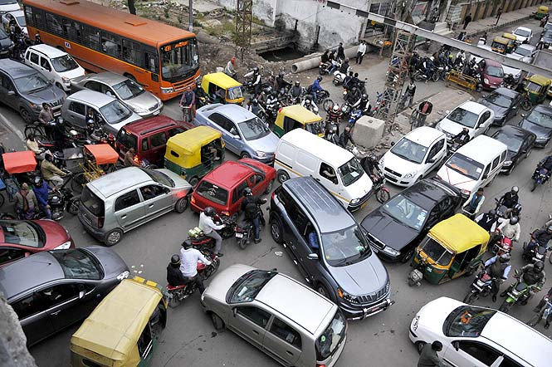
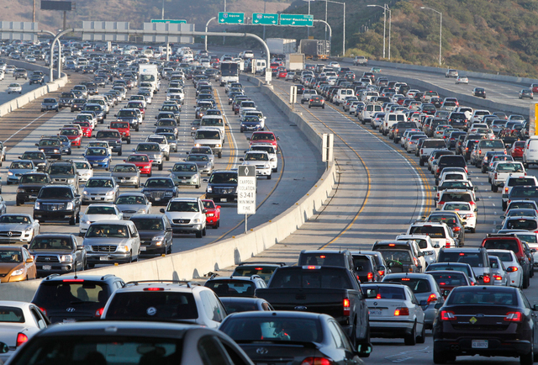
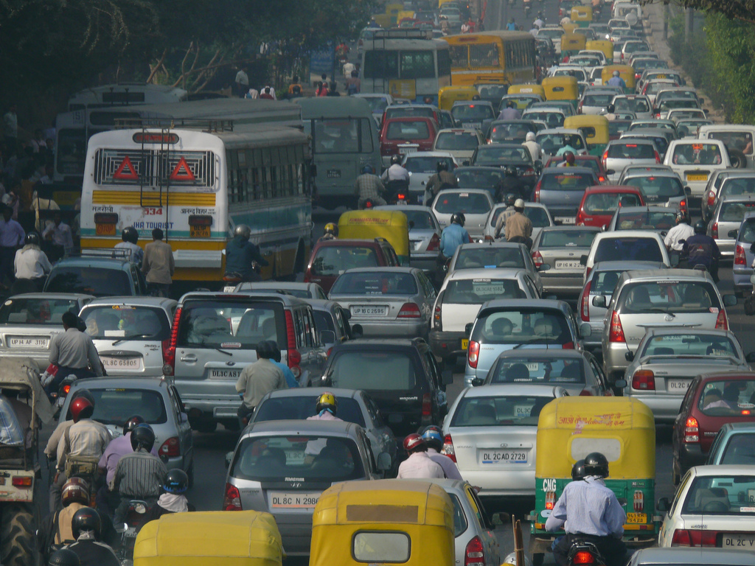
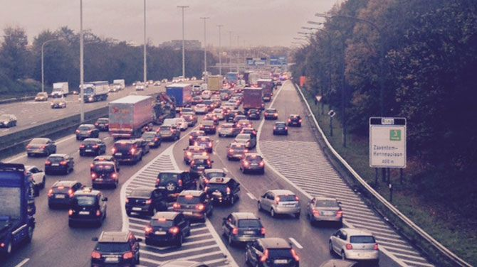
PROBLEM
TRAFFIC CONGESTION!!!!......

Slide 3
Possible Solutions
Using Public transport
Road widening
Infrastructural solution

Slide 4
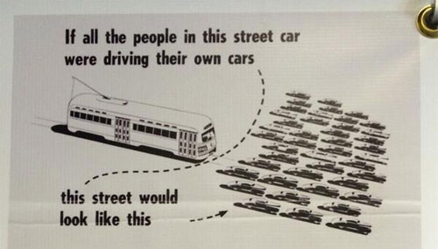

Slide 5
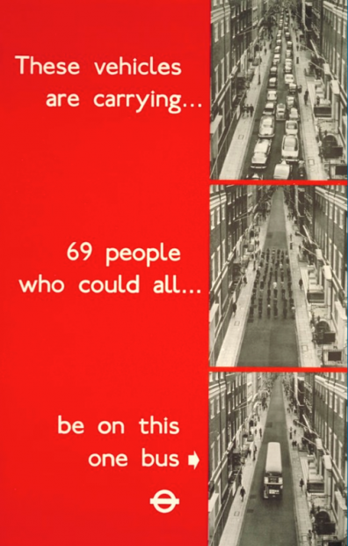

Slide 6
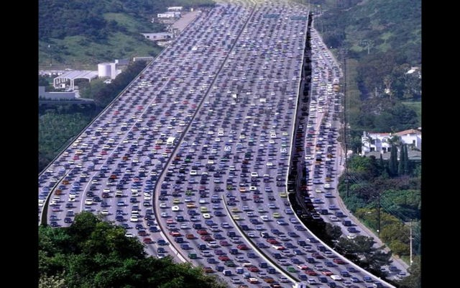
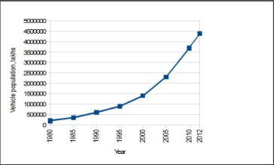

ROAD WIDENING
TRAFFIC IS DOUBLING EVERY 5 YEAR,
ILLOGICALLY WE ARE TRYING TO DOUBLE THE ROAD EVERY 5 YEAR.
ROAD SPACE CAN NEVER KEEP PACE WITH VEHICLE POPULATION.

Slide 7
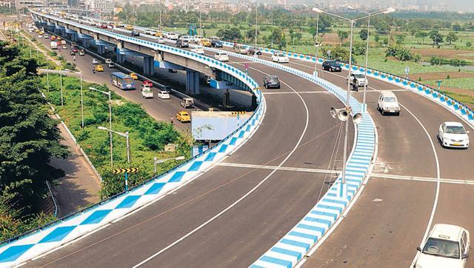
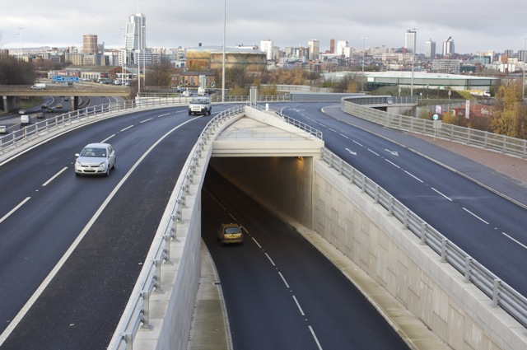
INFRASTRUCTURAL SOLUTION

Slide 8
NEED FoR a TRAFFIC PREDICToR

Slide 9
MODULES
DATA ACQUISITION
DATA QUANTIZATION
PREDICTION ENGINE
EVALUATION

Slide 10
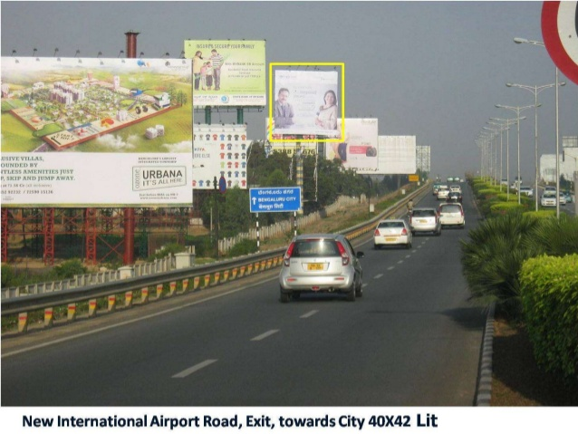
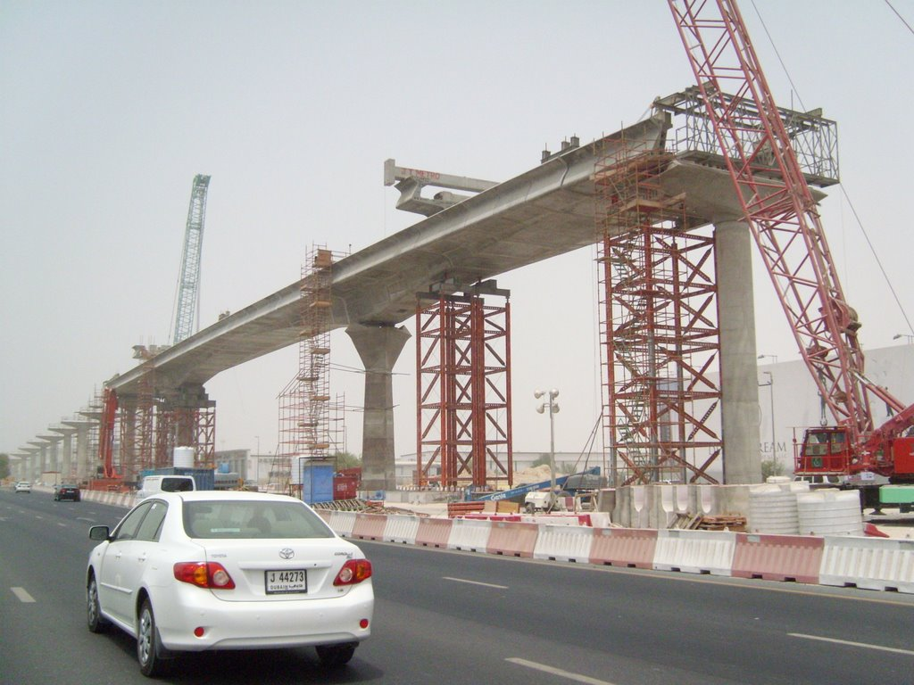
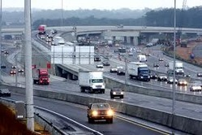
APPLICATIONS

Slide 11
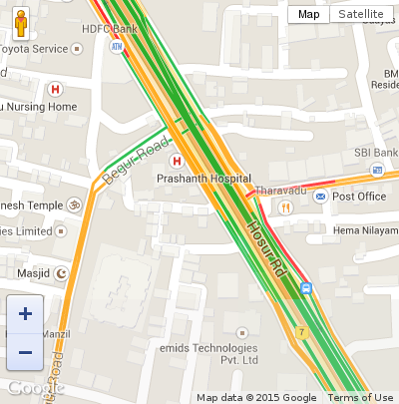
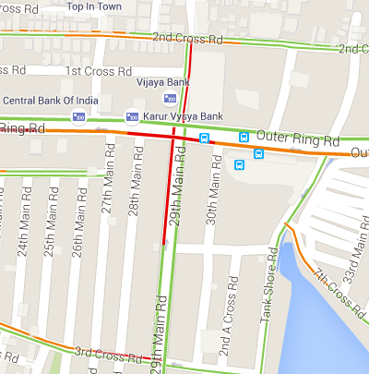
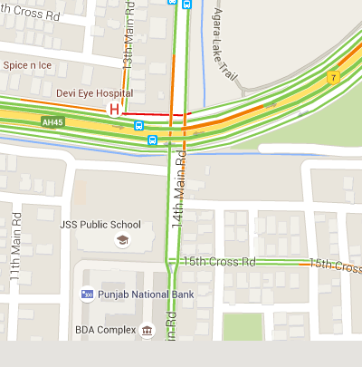
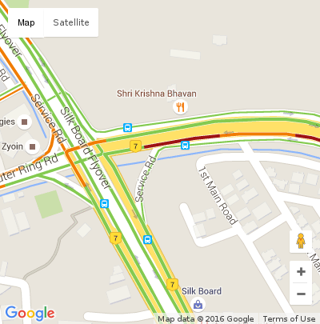
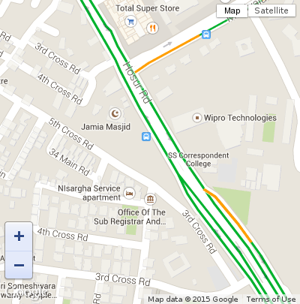
DATA ACQUISITION

Slide 12

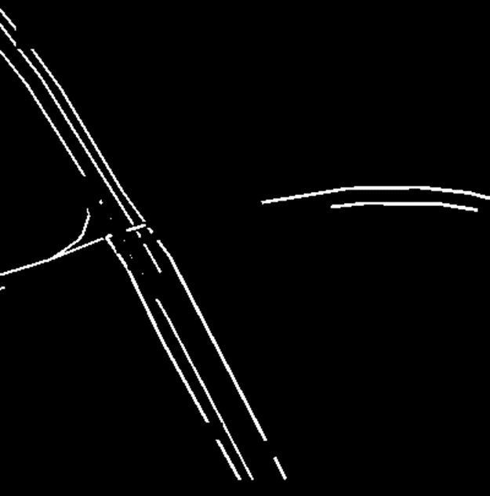
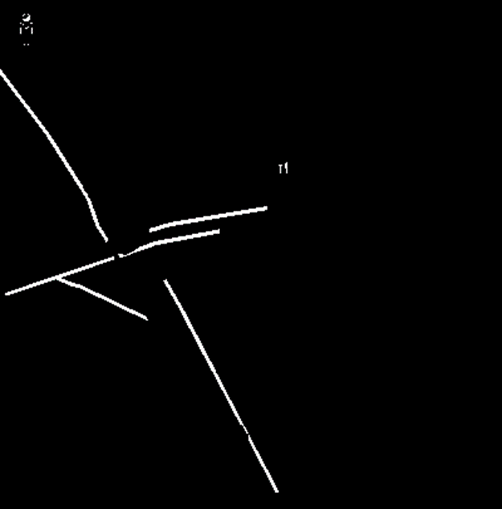
DATA QUantization
RED FILTERED IMAGE
GREEN FILTERED IMAGE
YELLOW FILTERED IMAGE

Slide 13
Prediction engine

Slide 14
evaluation
ALL DAYS CHART

Slide 24
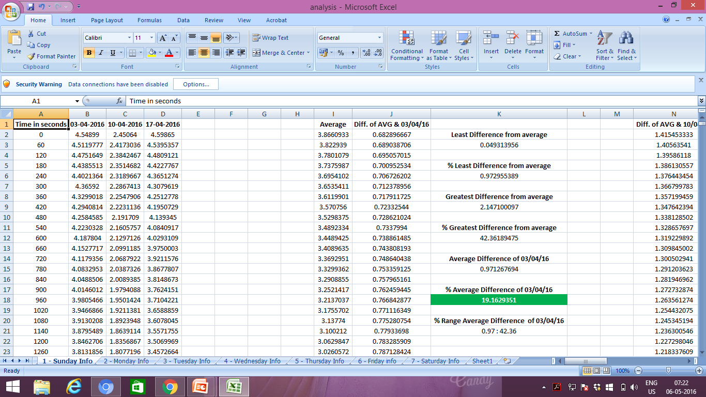

Slide 25
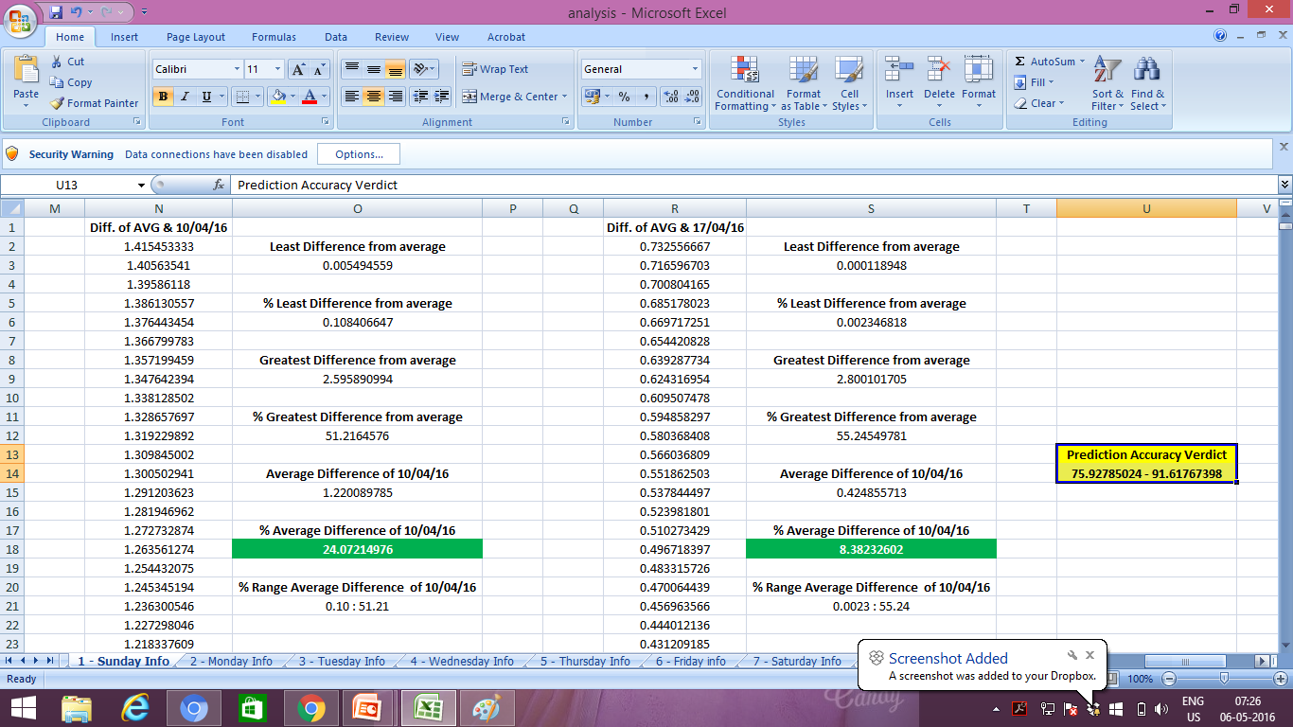

Slide 26
USER END
DEMONSTRATION

Slide 27


